Slide 1
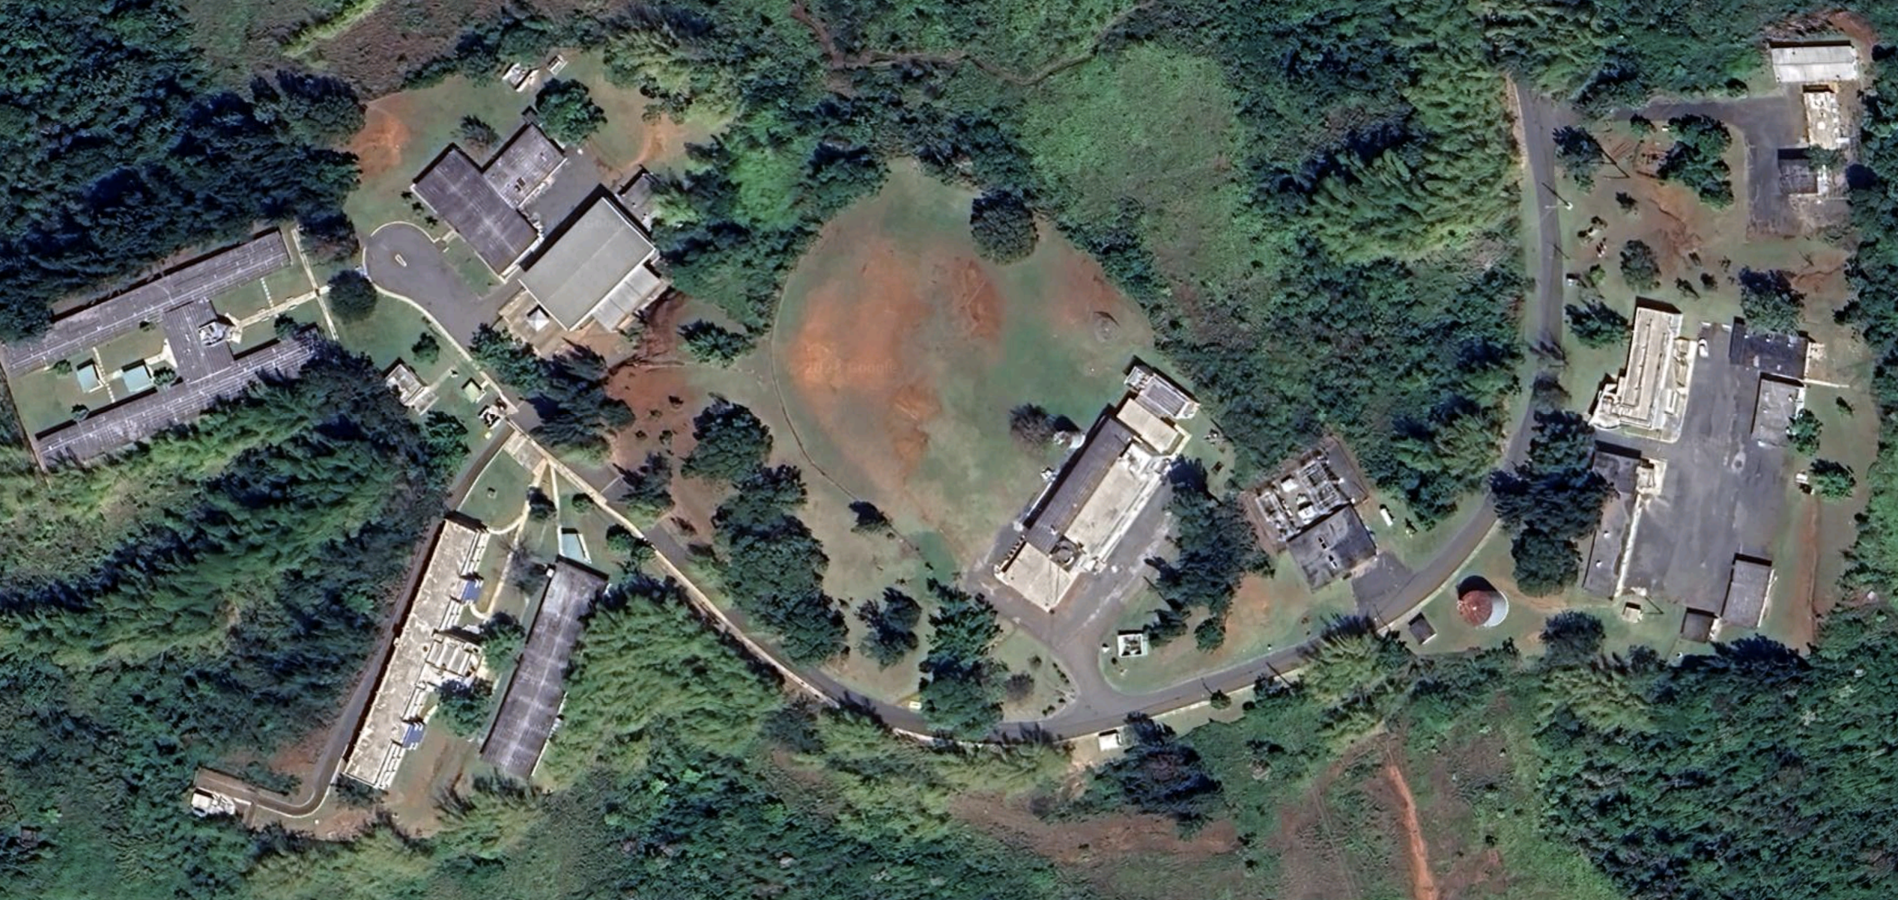
3
4
3
2
3
2
1
1
2
1
1
2
2
1
1
1

Slide 2
Perimeter 1:
1a31

Slide 3
Perimeter 2:
4g1a

Slide 4
Perimeter 3:
9j16

Slide 5
Perimeter 4:
71h4

